Slide 1
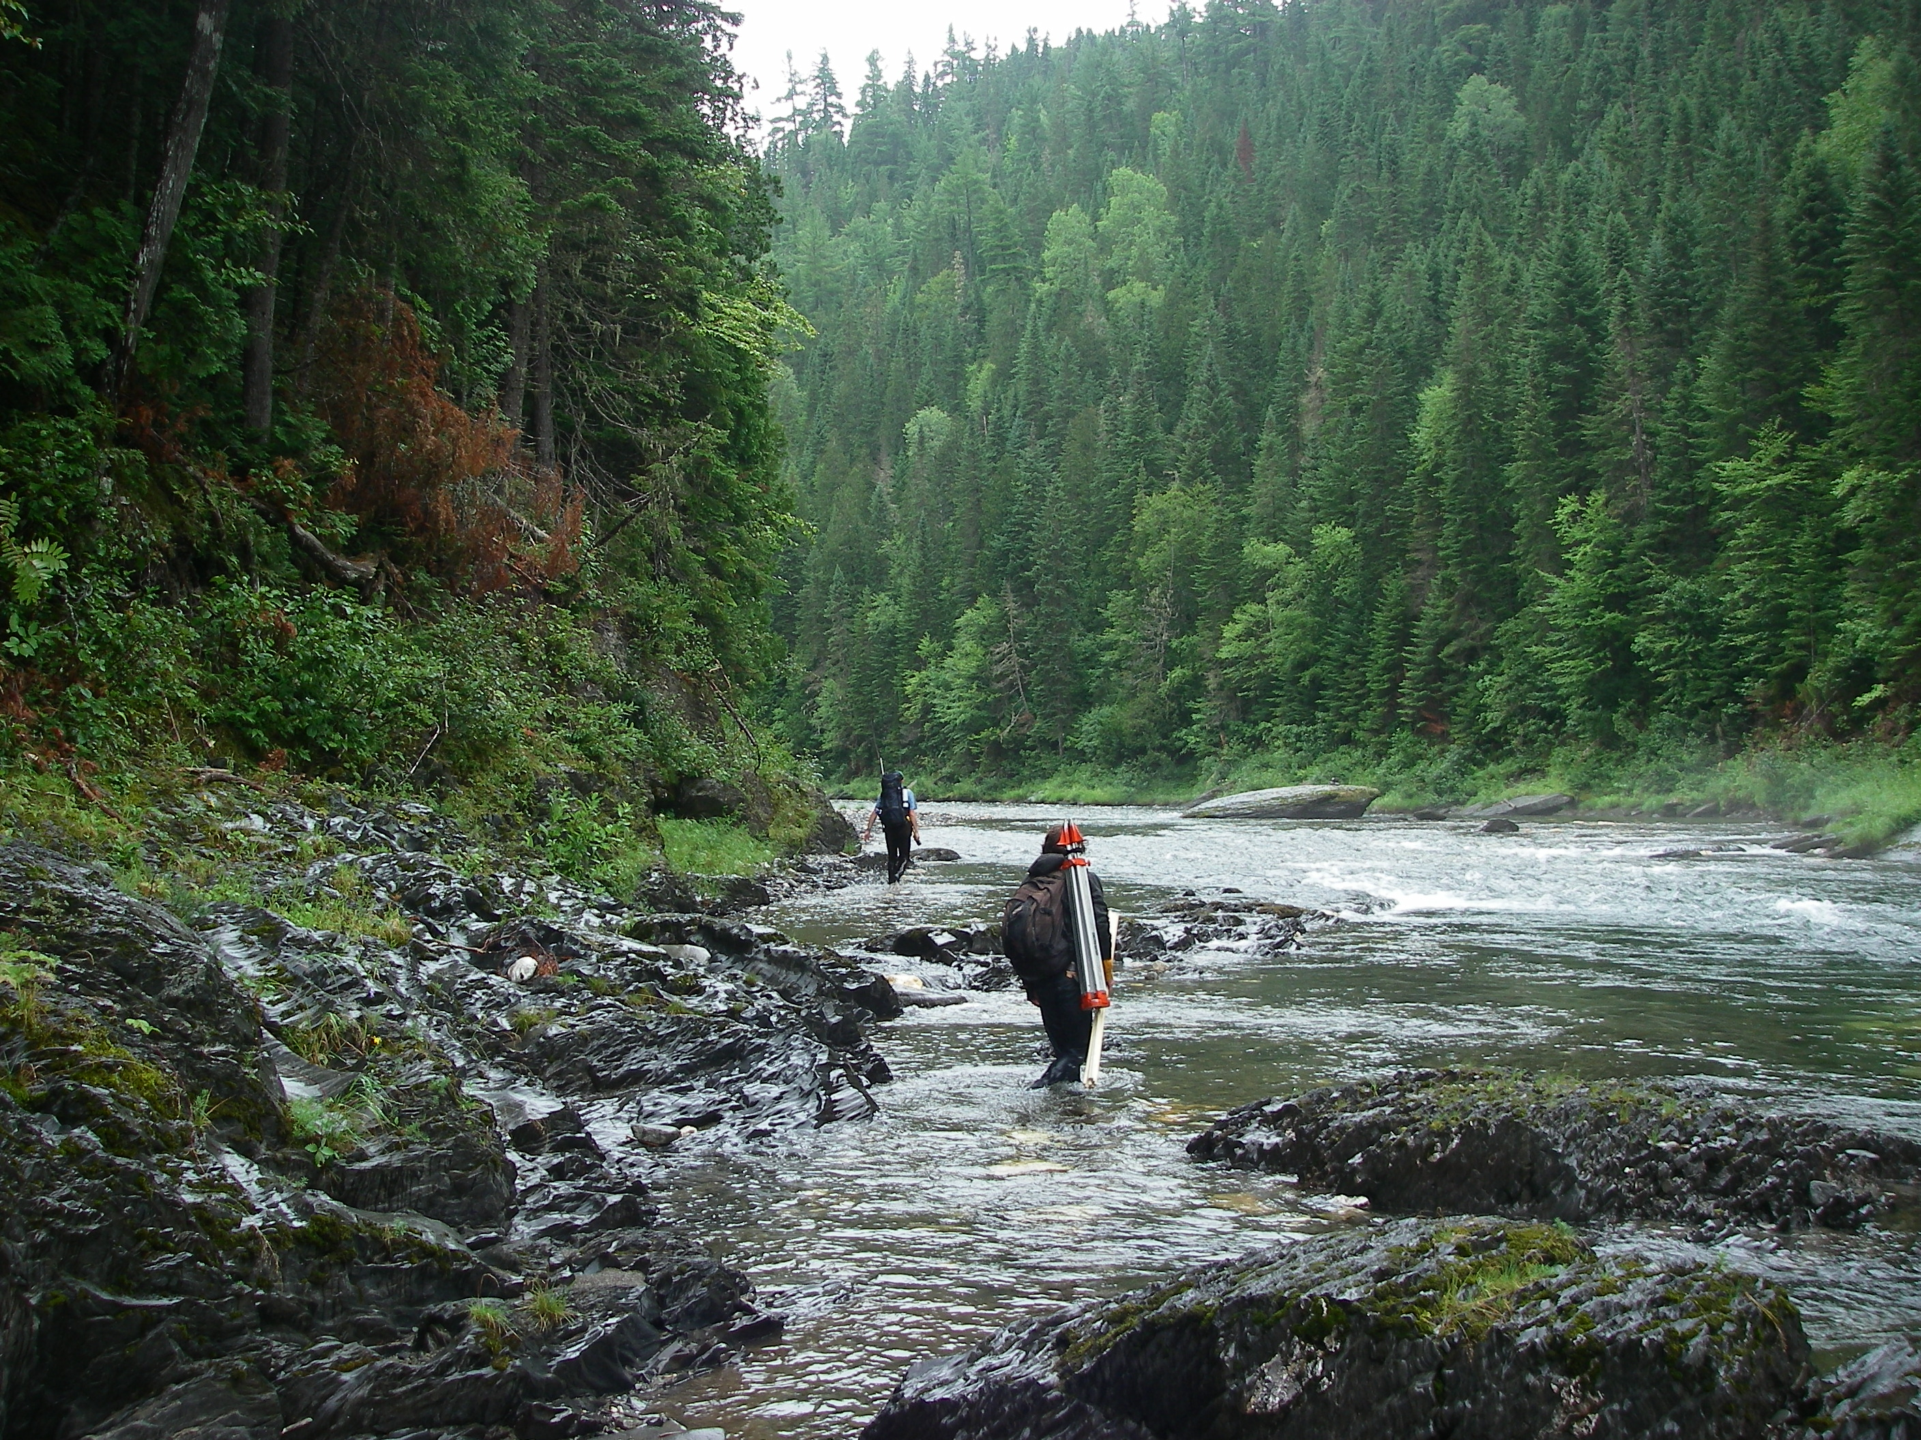
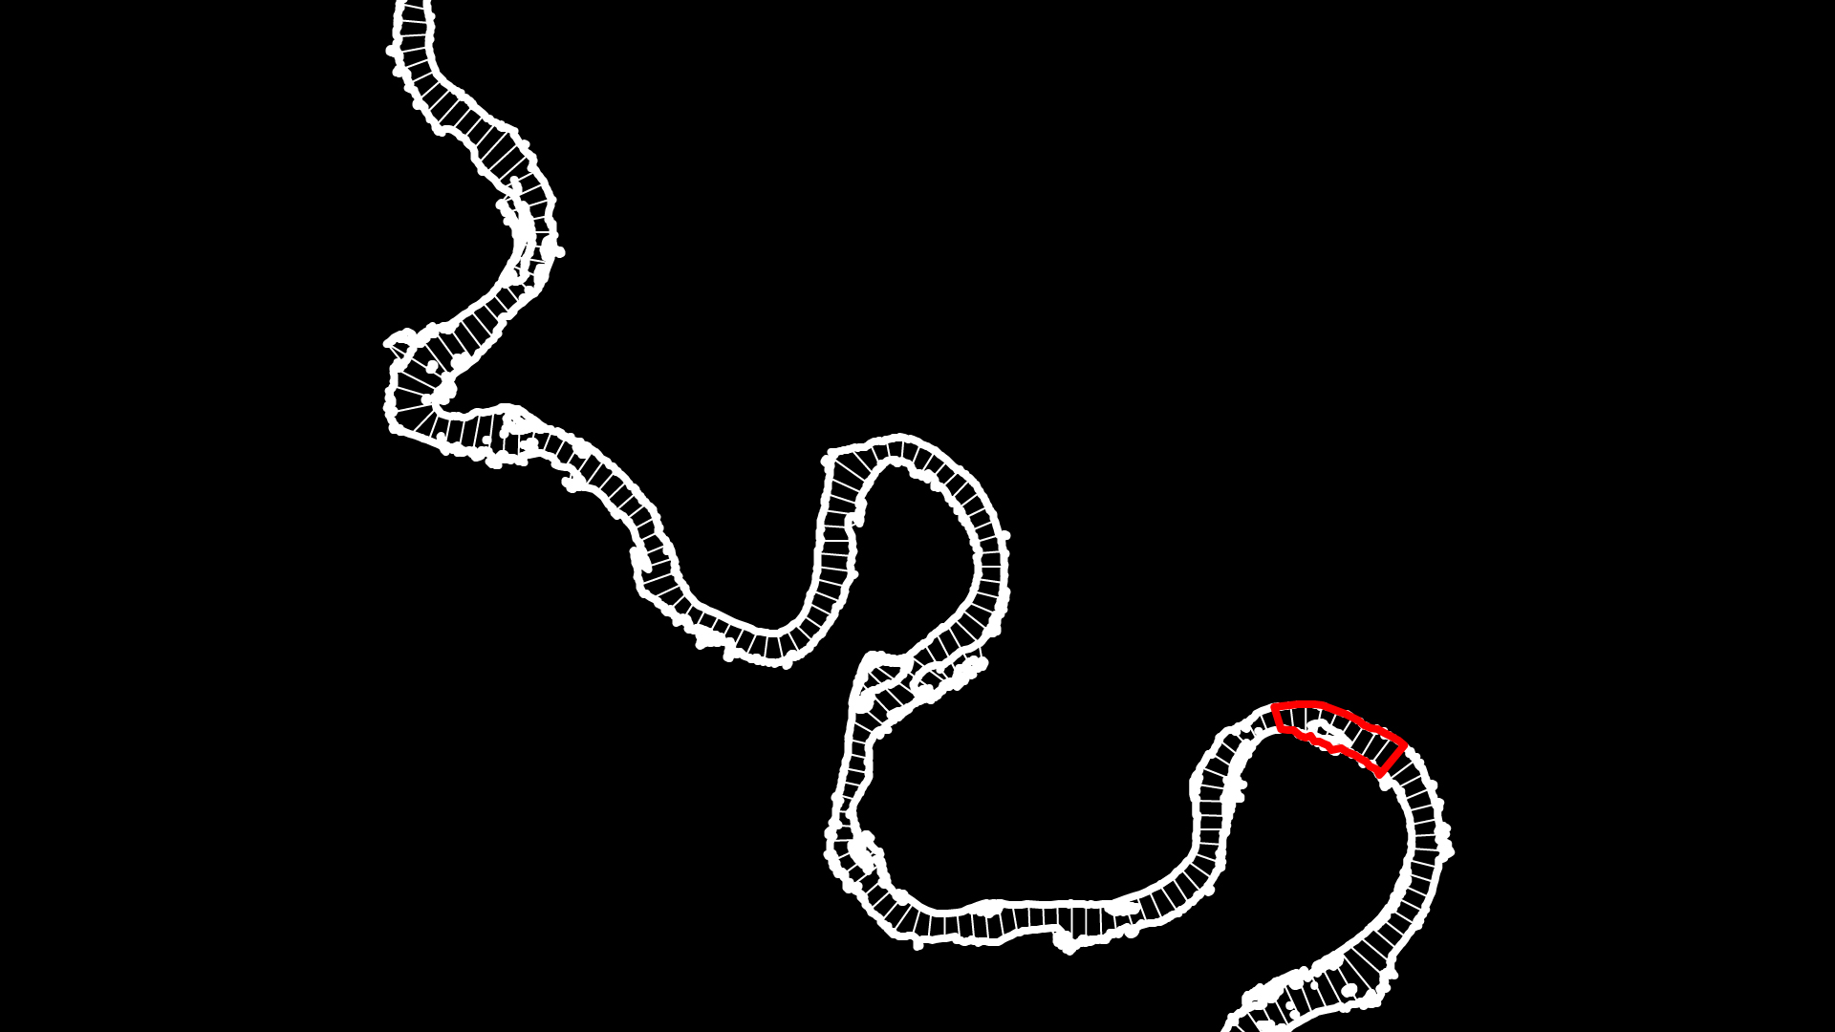
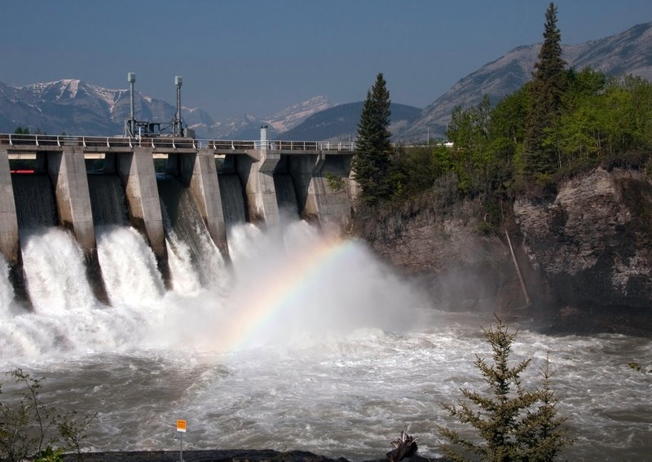


Fluvial Geomorphology: A GIS toolbox to extract raster data along spatial continuum
Lepoutre A., Research Assistant, Department of Geography, McGill University, Montreal
Developed in collaboration with phD Fabien Hugue under the supervision of Prof. Michel Lapointe.

Slide 2
NSERC HydroNet
“Hydropower is a leading source of electricity in Canada.
NSERC HydroNet is a national research network aimed at promoting sustainable hydropower and healthy aquatic ecosystems in Canada.
The general objectives of the network are to increase our understanding and develop new tools to better assess, minimize, and mitigate the effects of hydropower on fish and their habitats.”

Slide 3
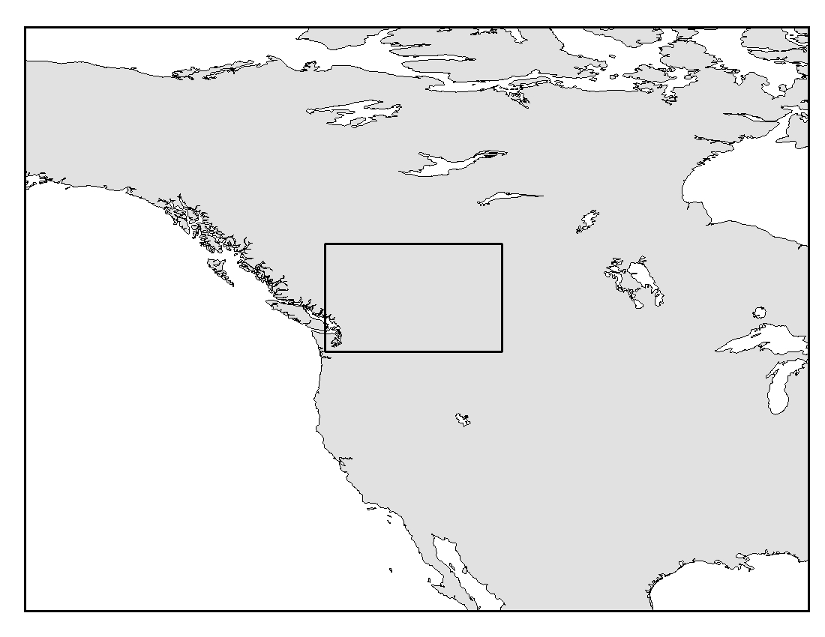
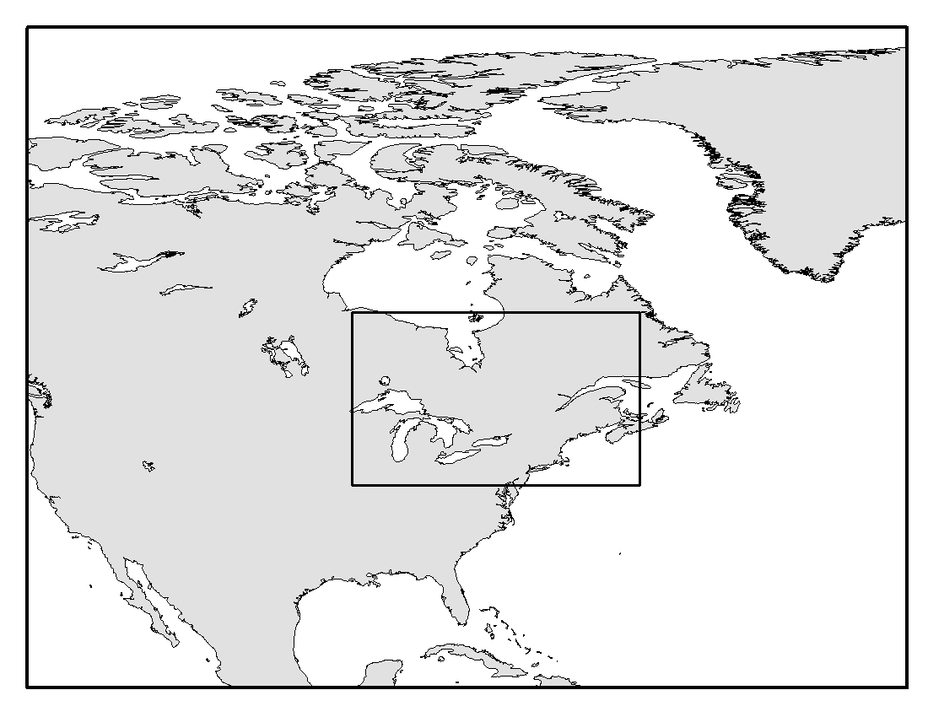
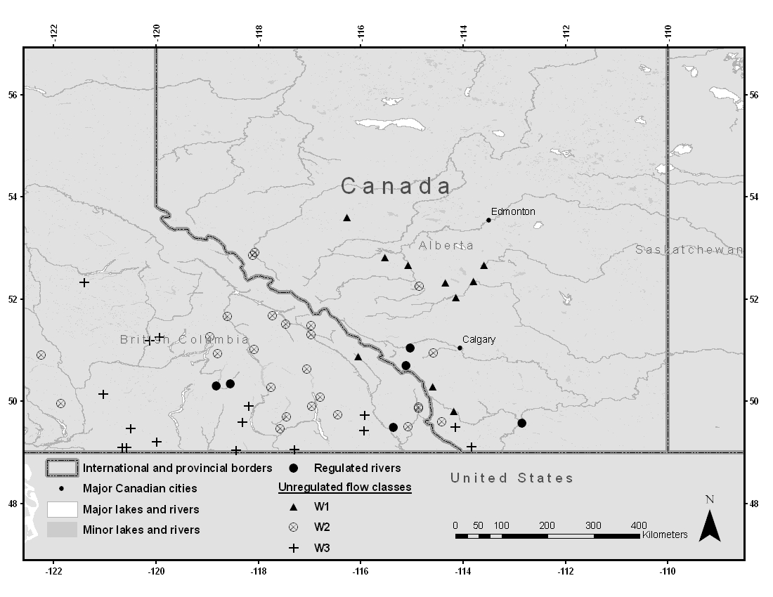
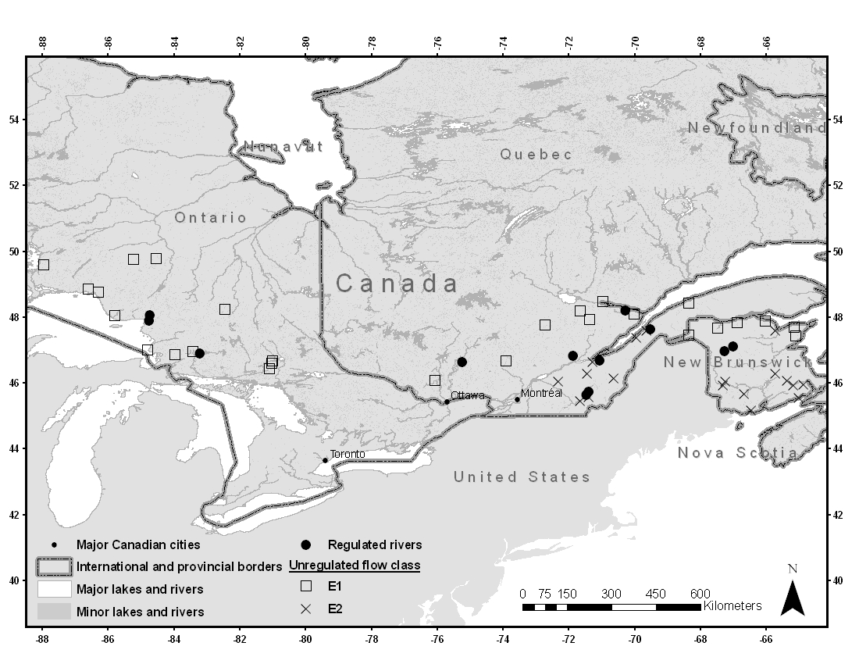
HydroNet study sites

Slide 4
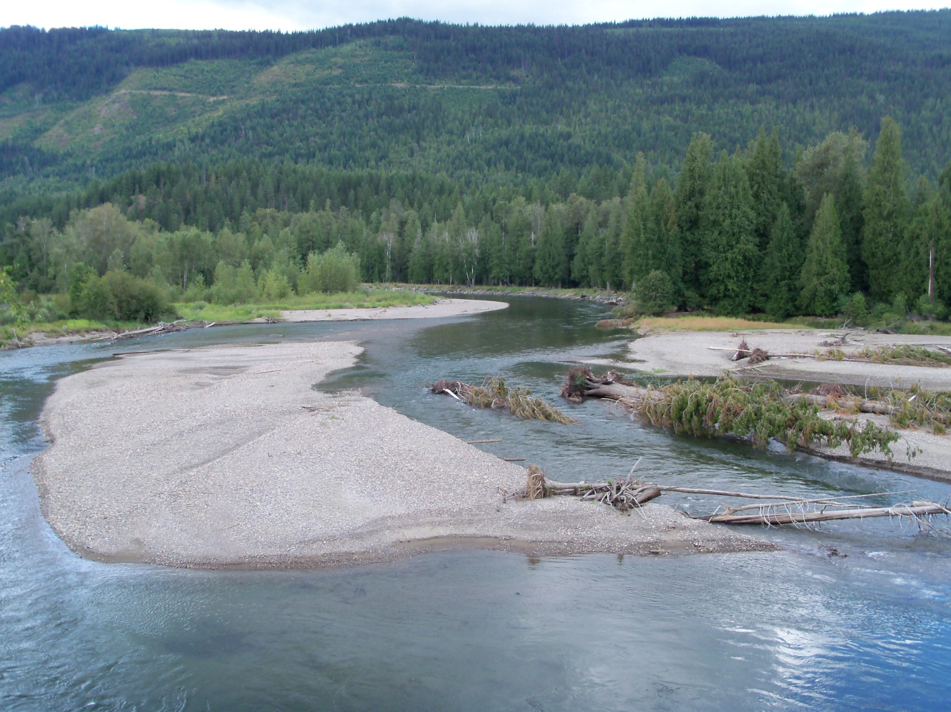
Example of in-situ habitat mapping

Slide 5
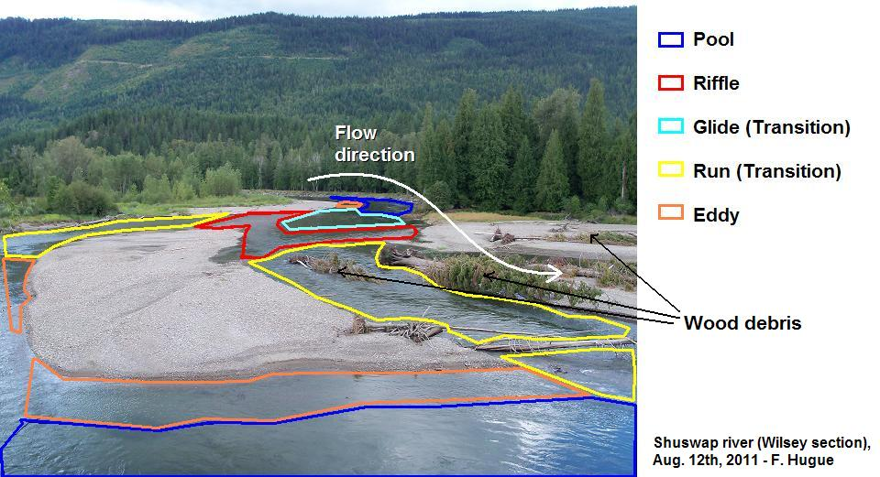
Example of in-situ habitat mapping
Can we assess habitat quality, damming impact for many rivers only with field data??

Slide 6
General objectives
Develop novel approach using remote sensing to describe meso, reach and 10km river scale habitat structure.
Understand the meso, reach and 10km river scale patterns of physical habitat variables (width, depth, slope, velocity, grain size, LOD, …)
Study specific reaches where fish habitat variables (wetted width, spawning sites, substrate embeddedness, riparian vegetation,…) are more likely to be impacted by damming
Assess river reach sensitivity to damming

Slide 7
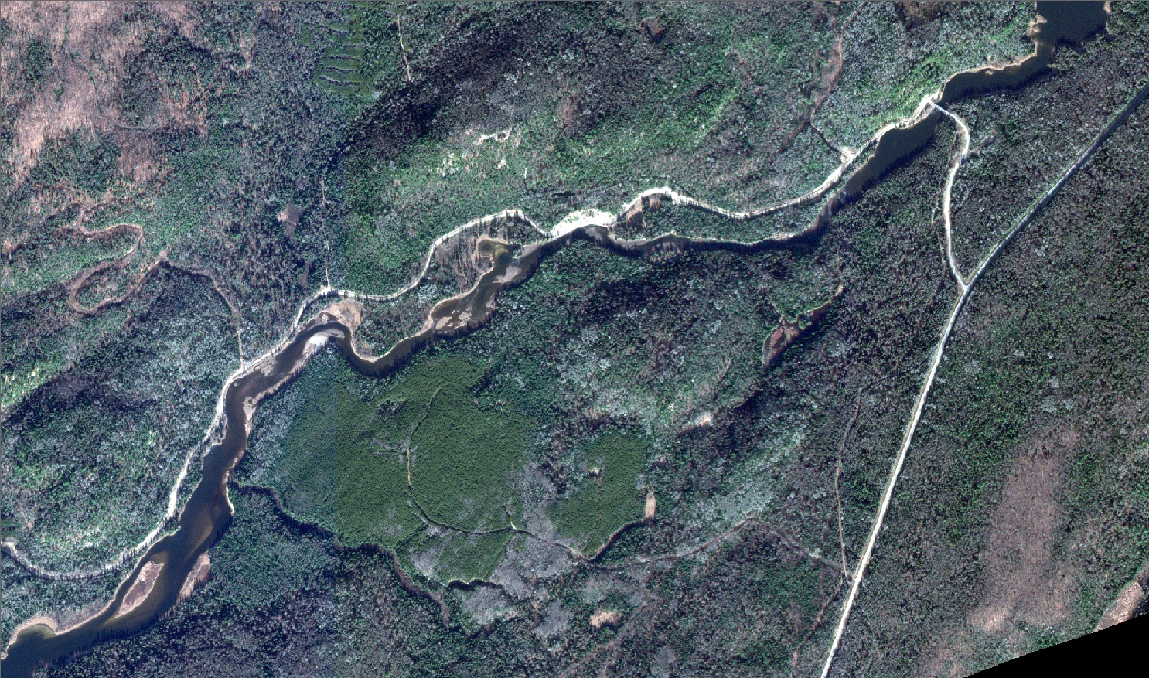
Solution: remote-sensing habitat assessment
Segmentation of the river stretch depending on the morphology
→ 4 identifiable sections
300 m

Slide 8
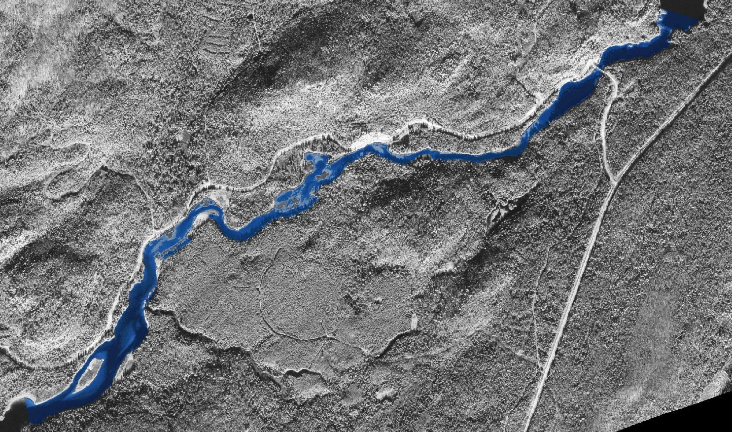
Solution: remote-sensing habitat assessement
Morpho-Type 1 (section 1, 4): Wide, deep, slow, mostly composed of massive pools
Morpho-Type 2 (section 2): Complex Pool-Riffle system
Morpho-Type 3 (section 3) : Straight, narrow and steep
→ Standardized method
Section 4
Section 2
Section 3
Section 1
300 m

Slide 9
Specific (tools) objectives
Extract and organize data in analytical way for different rivers, at different scales
Use relevant geometries for calculation of various parameters (fixed vs dynamic).
Flexible vector/raster/tabular data interactions
Automated method
Somewhat robust, large data loads
User-friendly

Slide 10
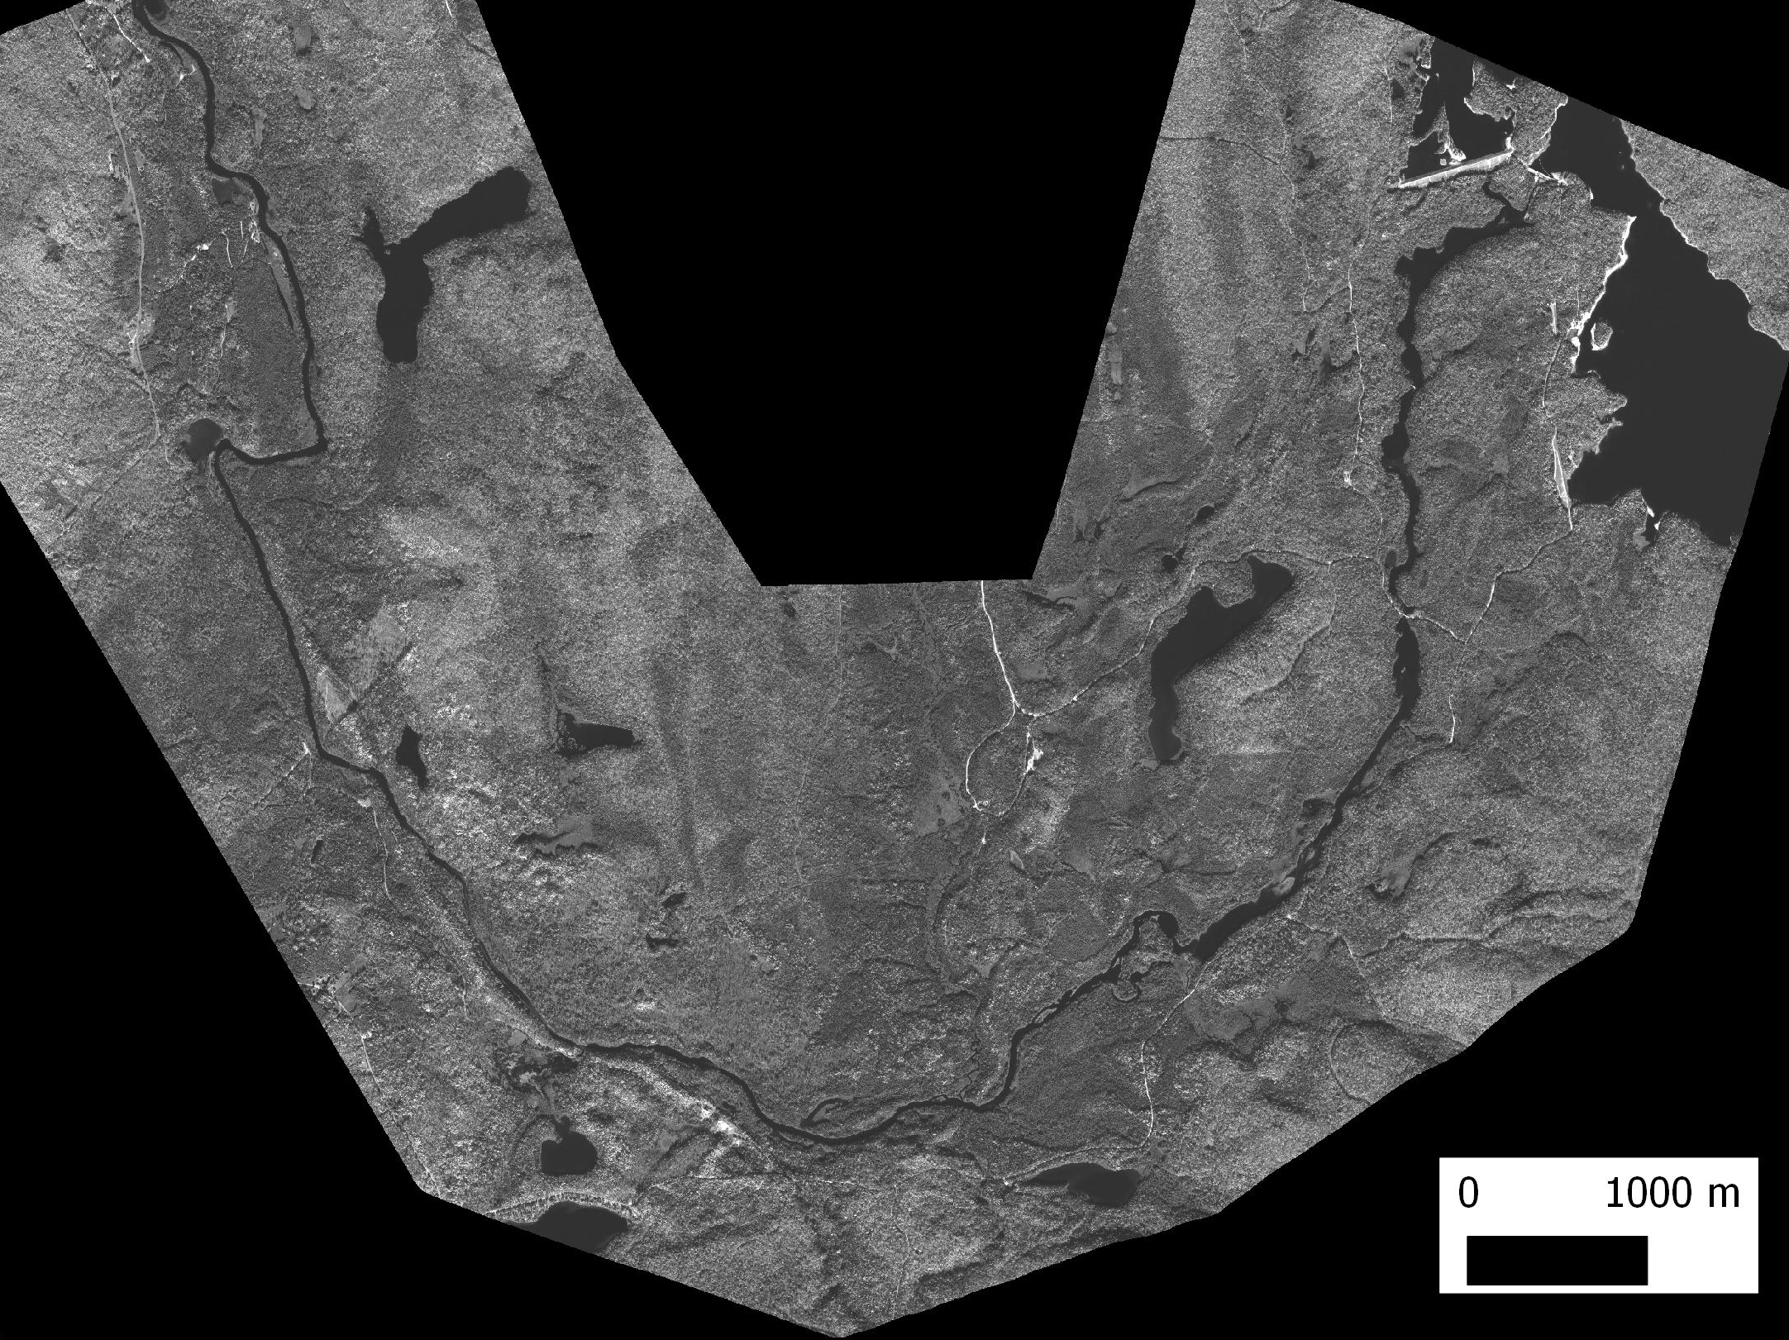
Inputs
(1) WorldView-II Satellite image:
Multispectral: 8 Bands (VIS-NIR) / 2 m res.
Panchromatic: 50 cm res.
Dam
Flow direction

Slide 11
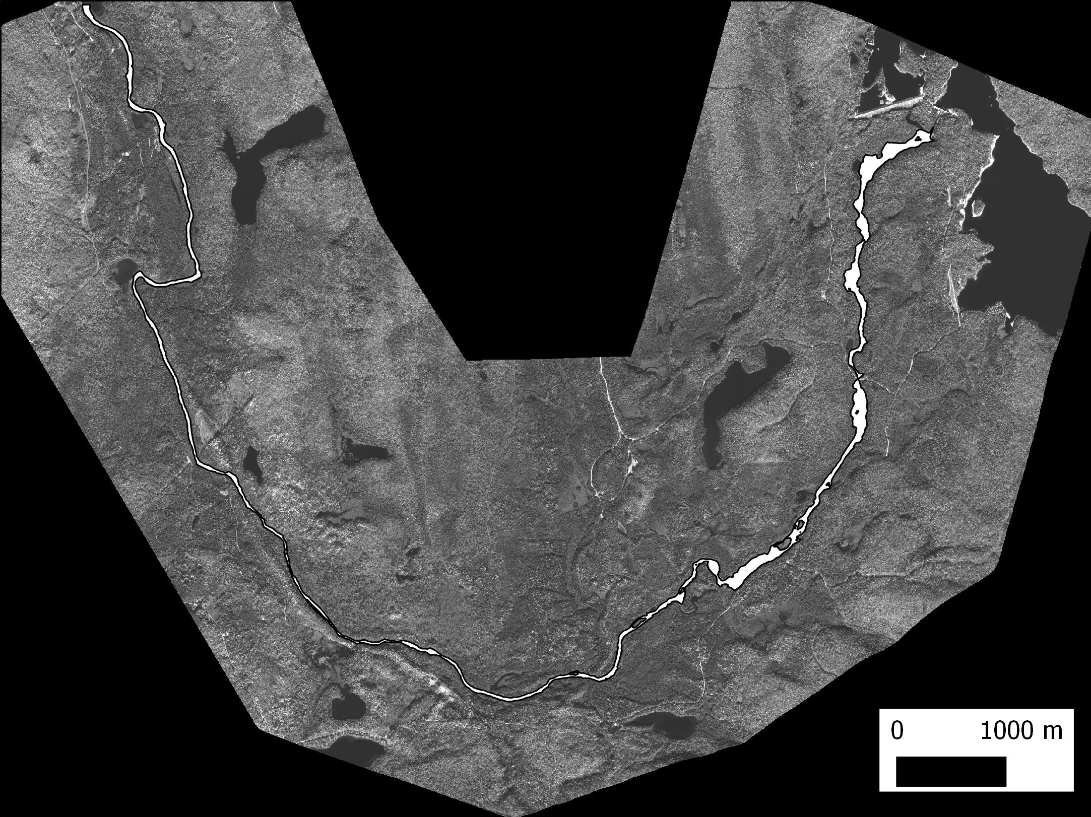
Inputs
(2) Watermask/spatial corridor
Dam
Flow direction

Slide 12
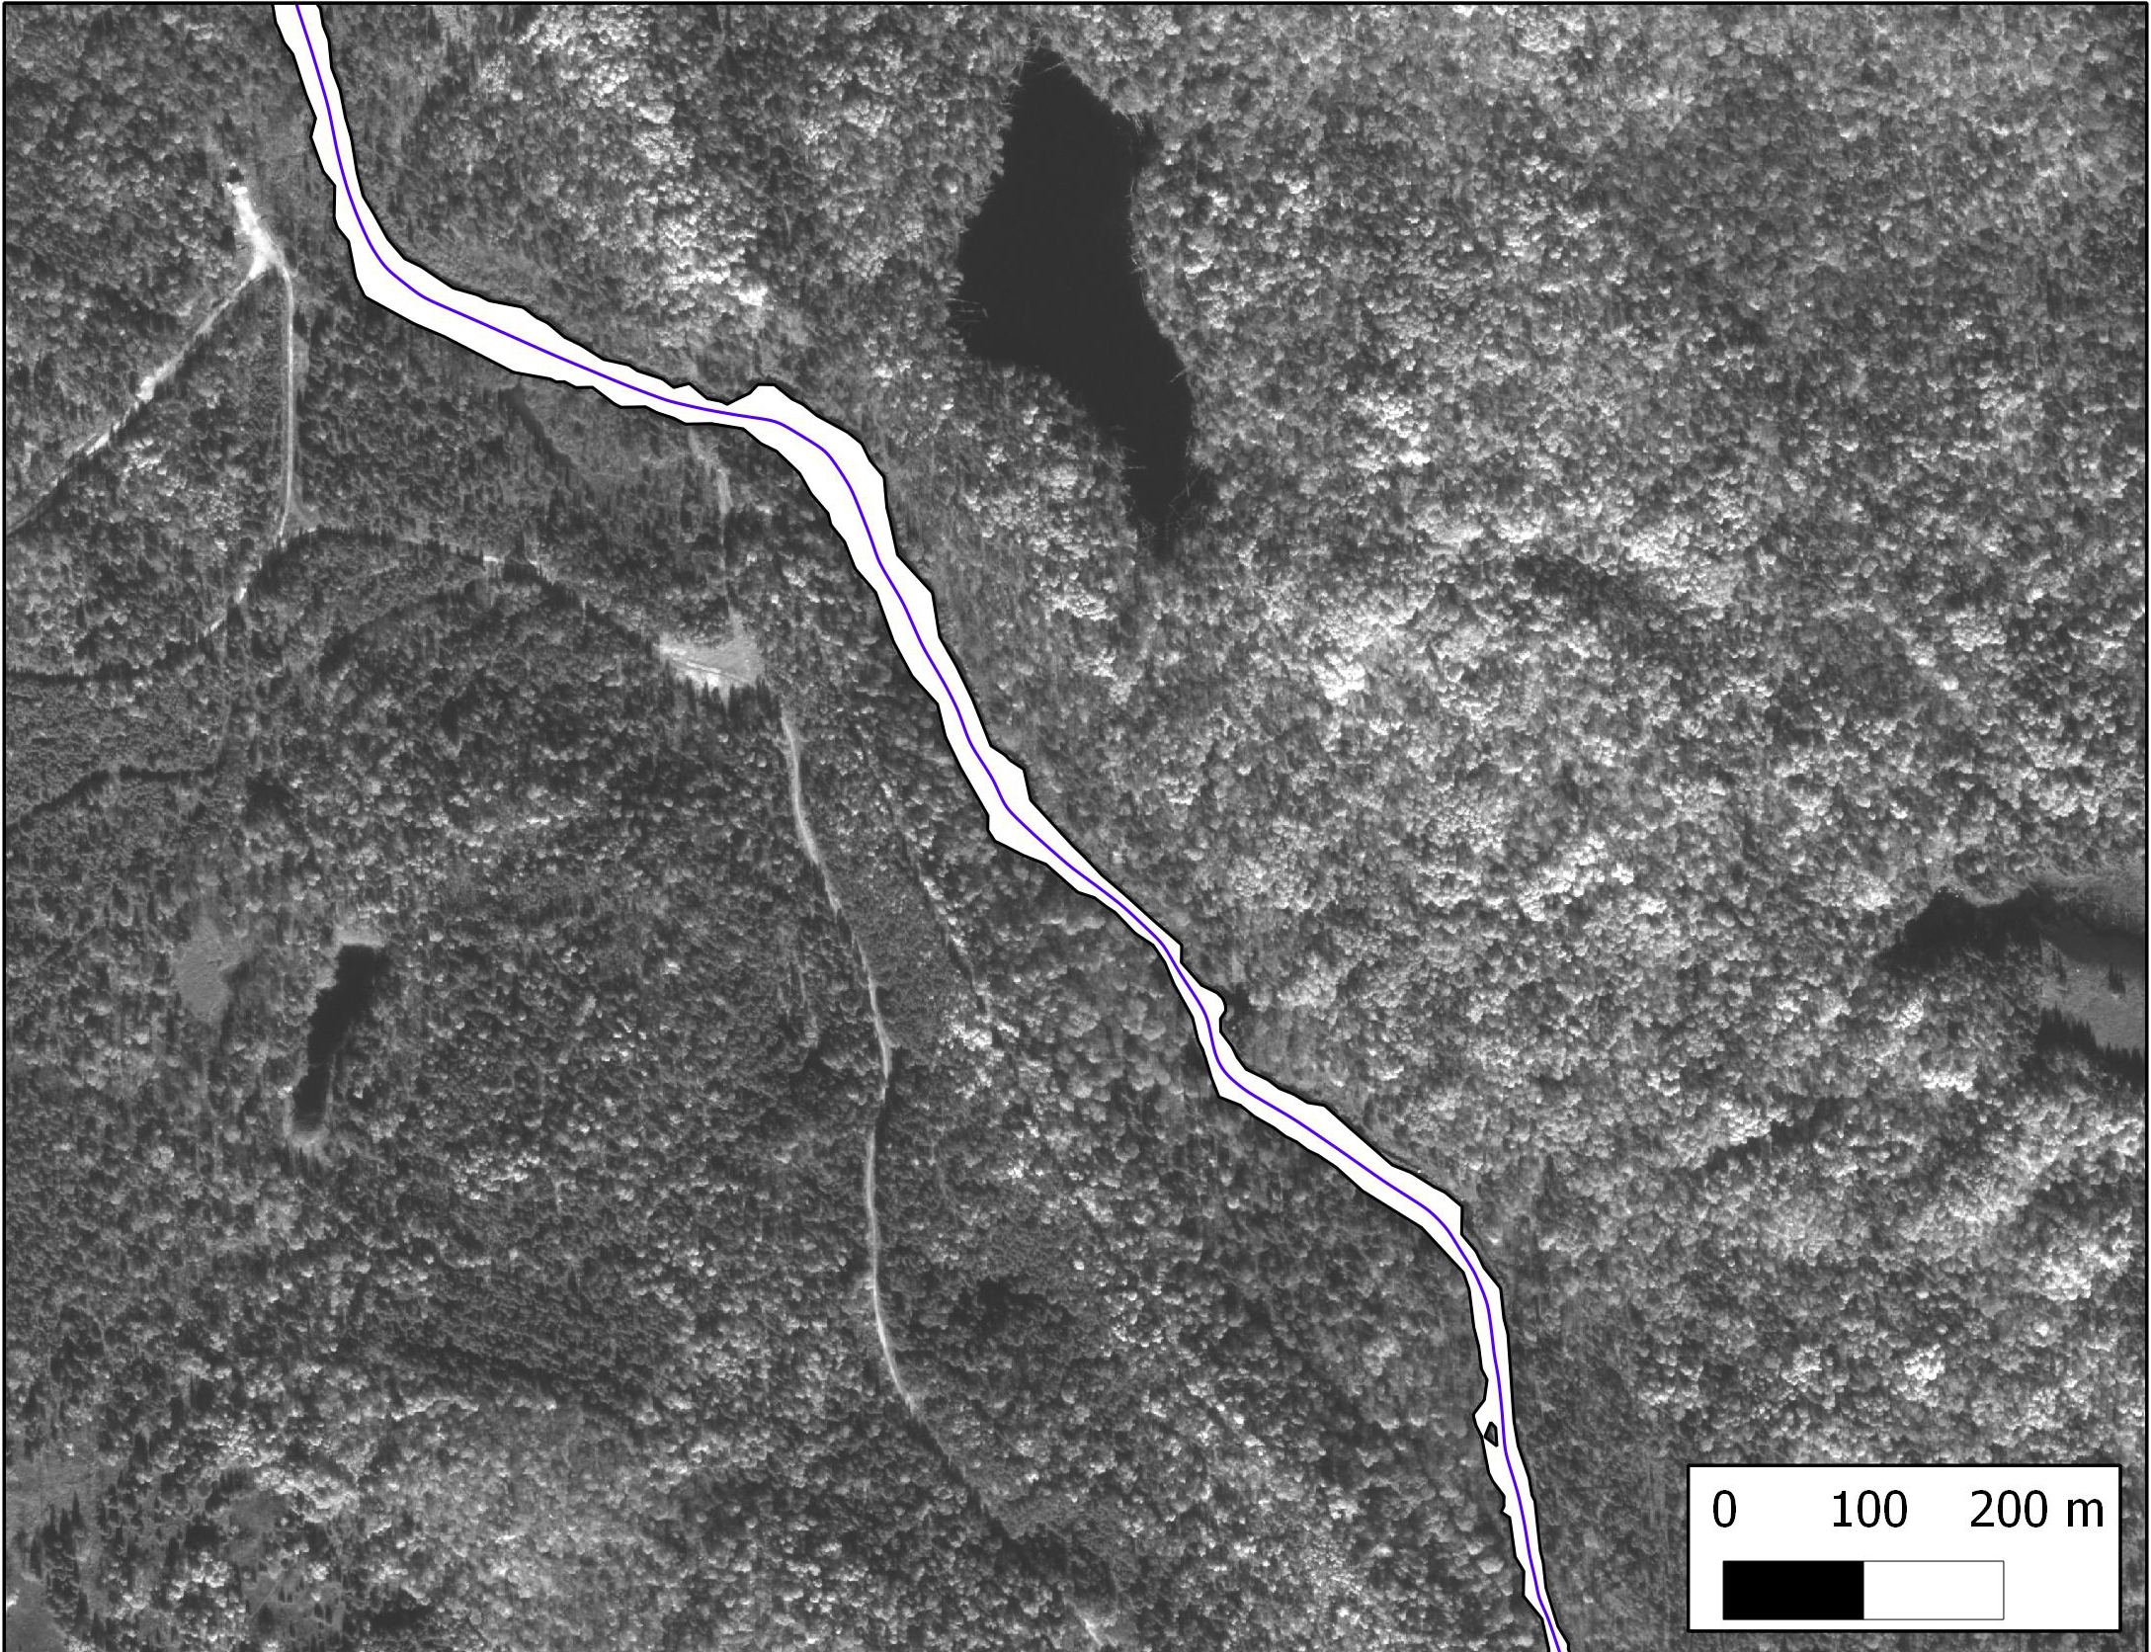
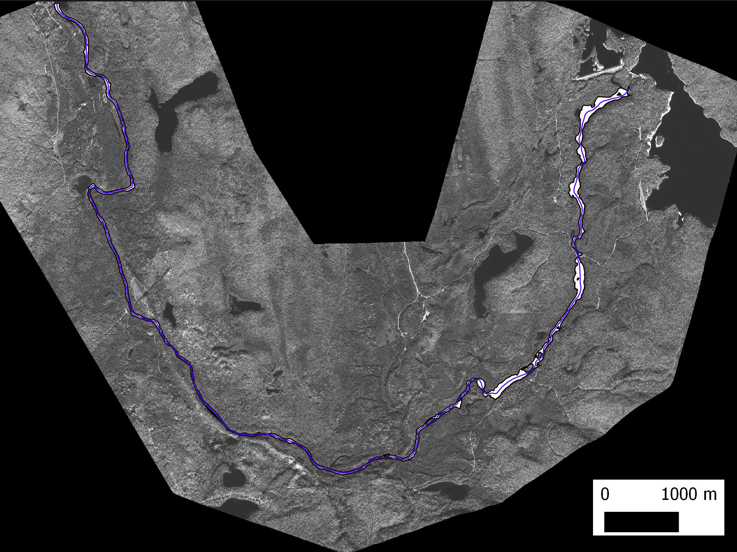
Inputs
(3) River centerline/baseline
Dam
Flow direction

Slide 13
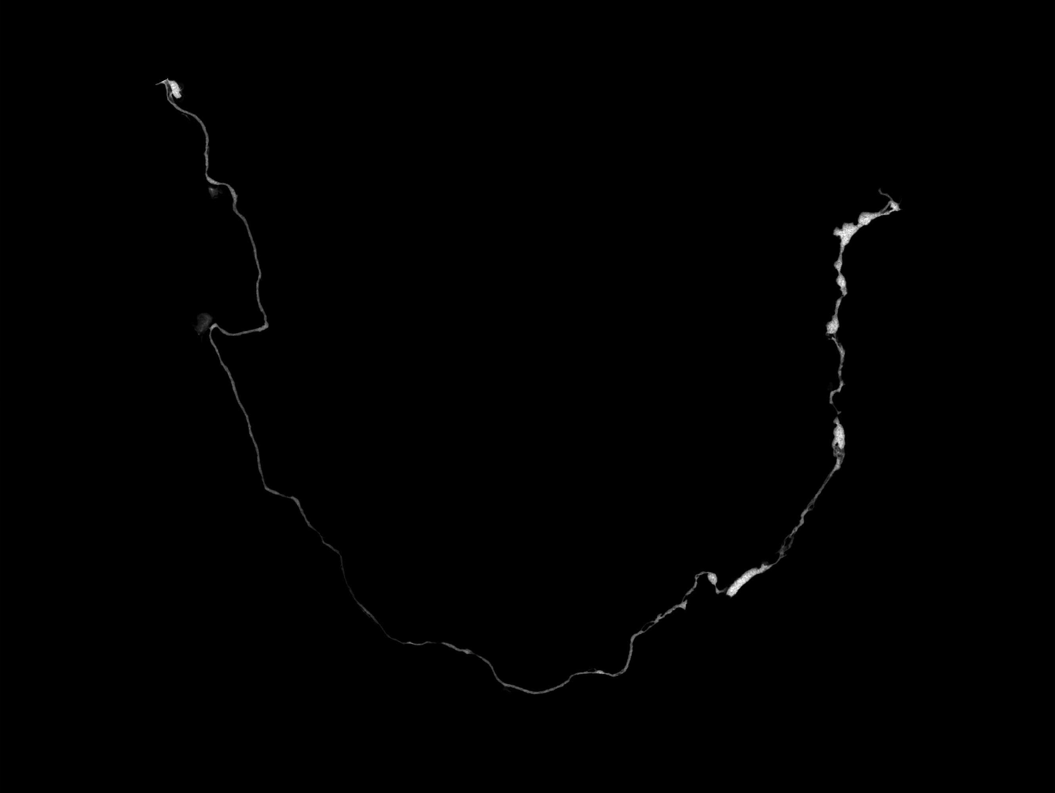
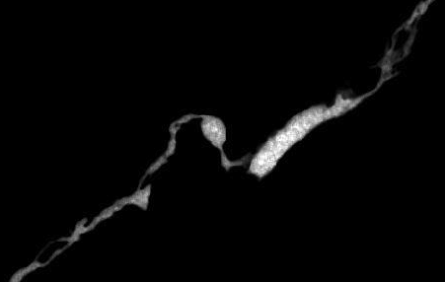
Inputs
Inputs
(3) Depth map (ENVI method)
(4) Raster: Depth map
-> field data for calibration + raster calculation

Slide 14
Create Transects
Cross-sections provide adequate geometry for fixed hydraulic and geomorphologic parameters (d & Q =>modelled v, channel width, # of channels,..).
Spatially discrete data: good for designing, mapping and validation of field surveys, in which surveyed path/areas can meander and change widths.
Provide an intra-river spatial reference system
=> transects create inputs for other tools.

Slide 15
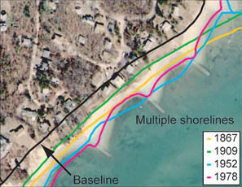
Transects along centerline solutions
Many applications => many solutions
Hydraulic research RivWidth from Tamlin
Coastal erosion/accresion research (DSAS,“Beach tools”,...)
Gerry Galbrisch arc9.3 solution
Custom solution => slope extraction in meandering environment optimized

Slide 16
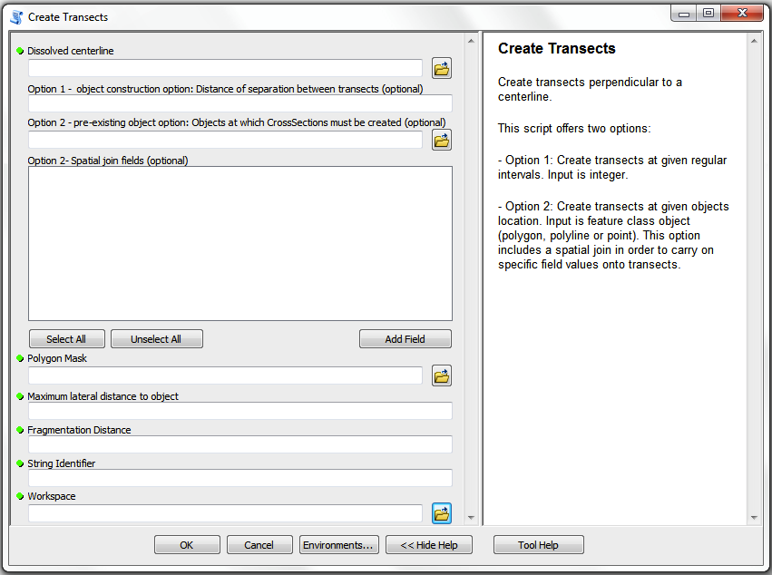
Create Transects
Fluvial Geomorphology’ transects specifics:
Many rivers => many situations. Implementation where slope calculation handles sinuosity well
For field work: option to create transects
Need transects to be clipped

Slide 17
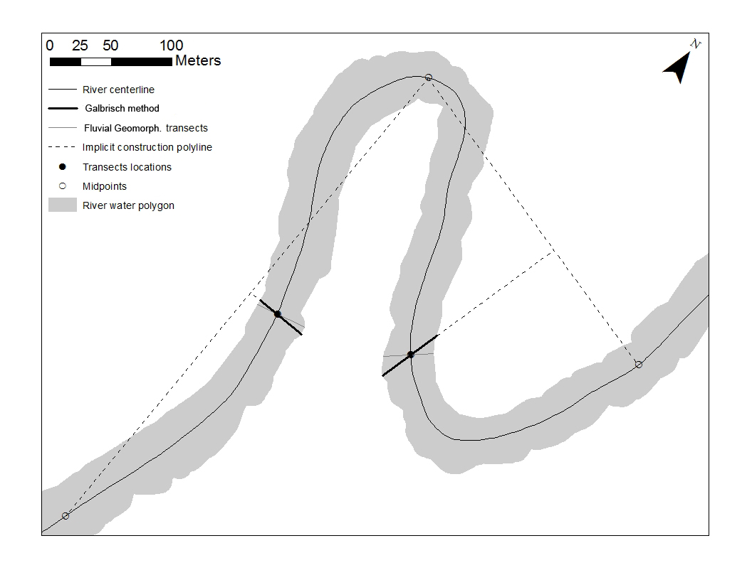
Create Transects – Slope extraction

Slide 18
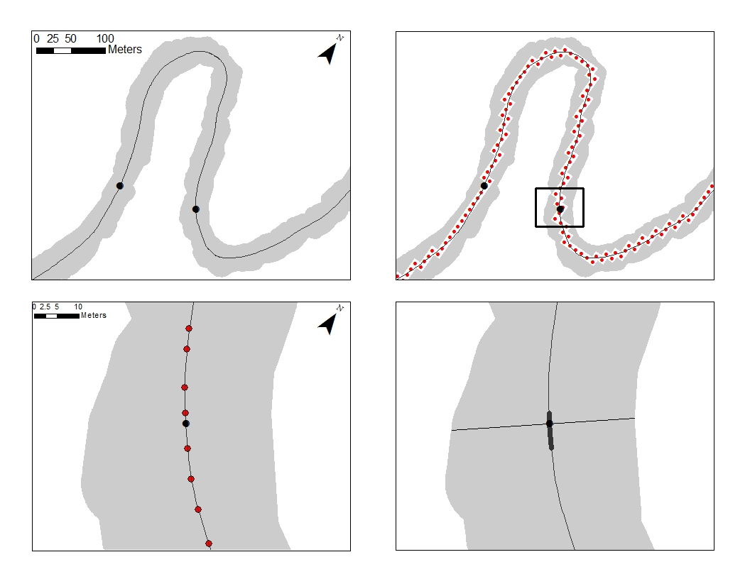
Create Transects – Slope extraction

Slide 19
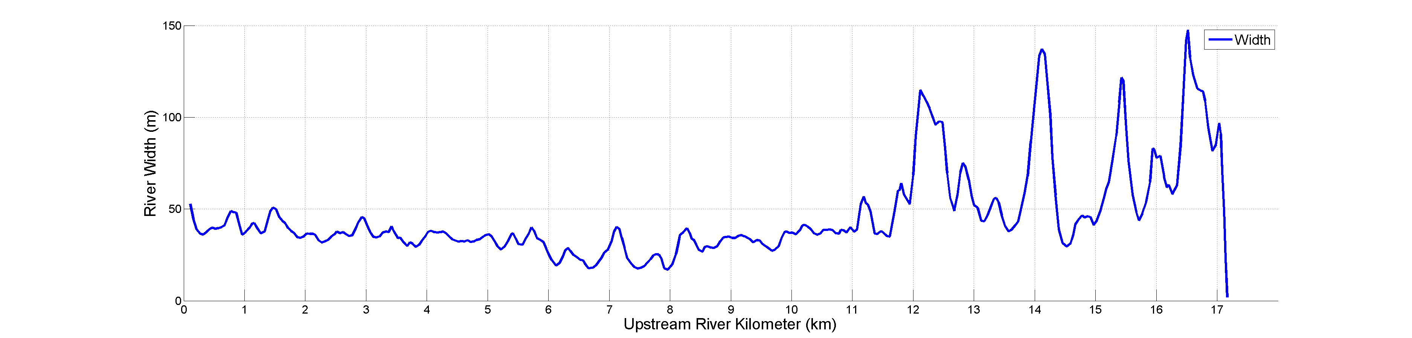
Transects: Resulting outputs (1)
River width profile:

Slide 20
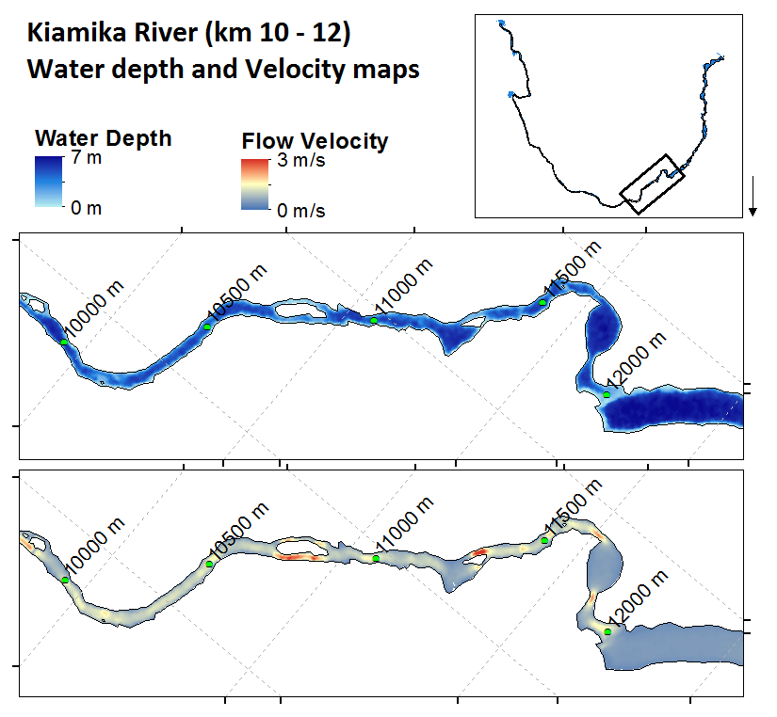
Transects: Results (2)
Depth map + Discharge + Transects
2D Velocity estimates:
Continuity equations
Based on data extracted by cross-sections on the image
(Manning’s law, Du Boys, Log profile law)
Interpolation with barriers
Velocity raster

Slide 21
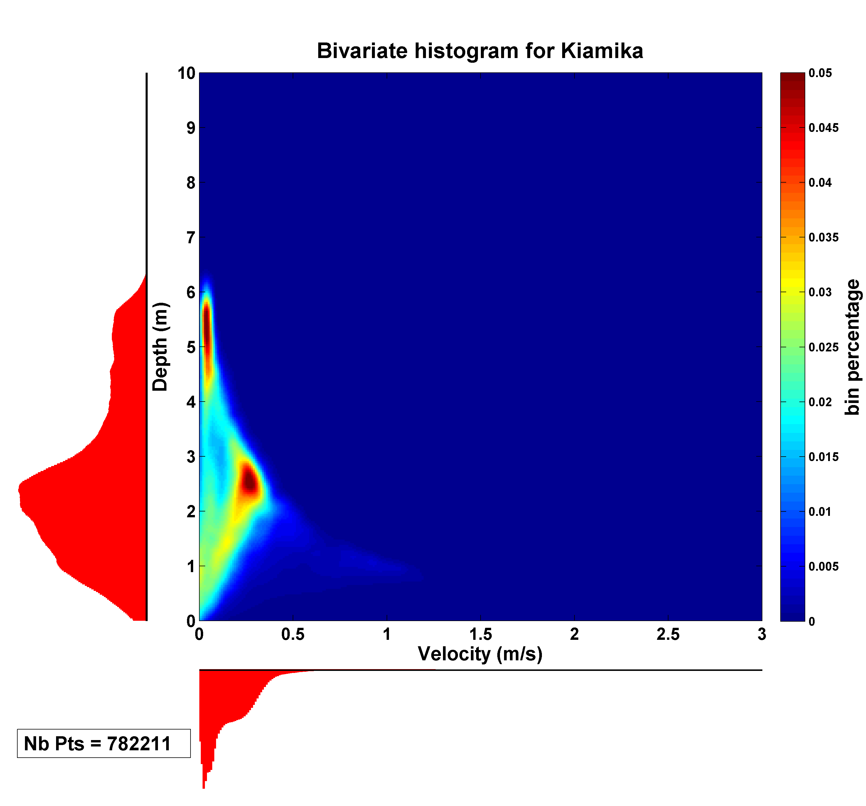
Transects: Results (3)
Habitat 1: Deep and slow (Pools)
Habitat 2: Medium depth and
fairly rapid (Runs)

Slide 22
Transects: Results (3)
Illustration for Depth-Velocity optima of a generic fish (Brook Trout)
Global river morpho. : yield parameters for Moving Window

Slide 23
Moving Window Solutions
Hawth’s tool: roving window…arc9.3 and discontinued
Thomas Dilts' Stream Gradient and Sinuosity Toolbox…never worked for me "Invalid Tool: Unable to execute the selected tool" ..designed in 9.2

Slide 24
Moving Window
Provide: 1) fixed “entities” of data on which statitics and metrics can be calculated 2) entities have location that allows them to be related spatially to a reach, river scales.
Overlap of polygons provide smoothing of stream of data, possibility of dynamic visualization => global trends & local trends.
Continuous data => More complex metrics for habitat characterization not necessarily visually obvious (modal peak, Hydro-Morphological Index of Diversity, % of pixels outside boxes defined from global bivariate,..) .

Slide 25
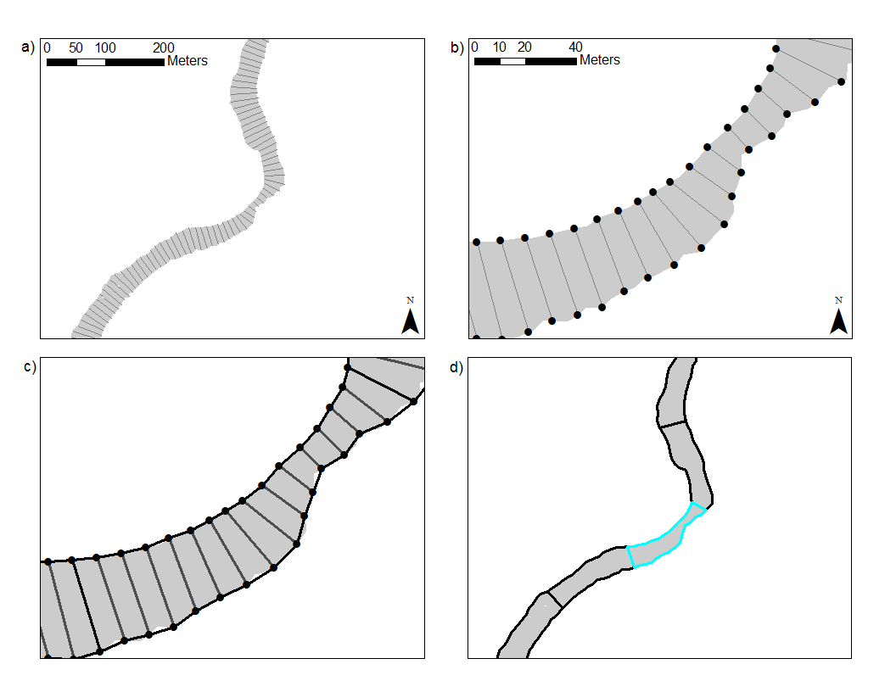
Moving Window - Inputs/Outputs & Implementation
Inputs:
-specific parameters
-water polygon
-transects
-Centerline
-Rasters
Outputs:
-raster pixel values in text
file for each polygon
-polygon shp
Exported .txt files

Slide 26
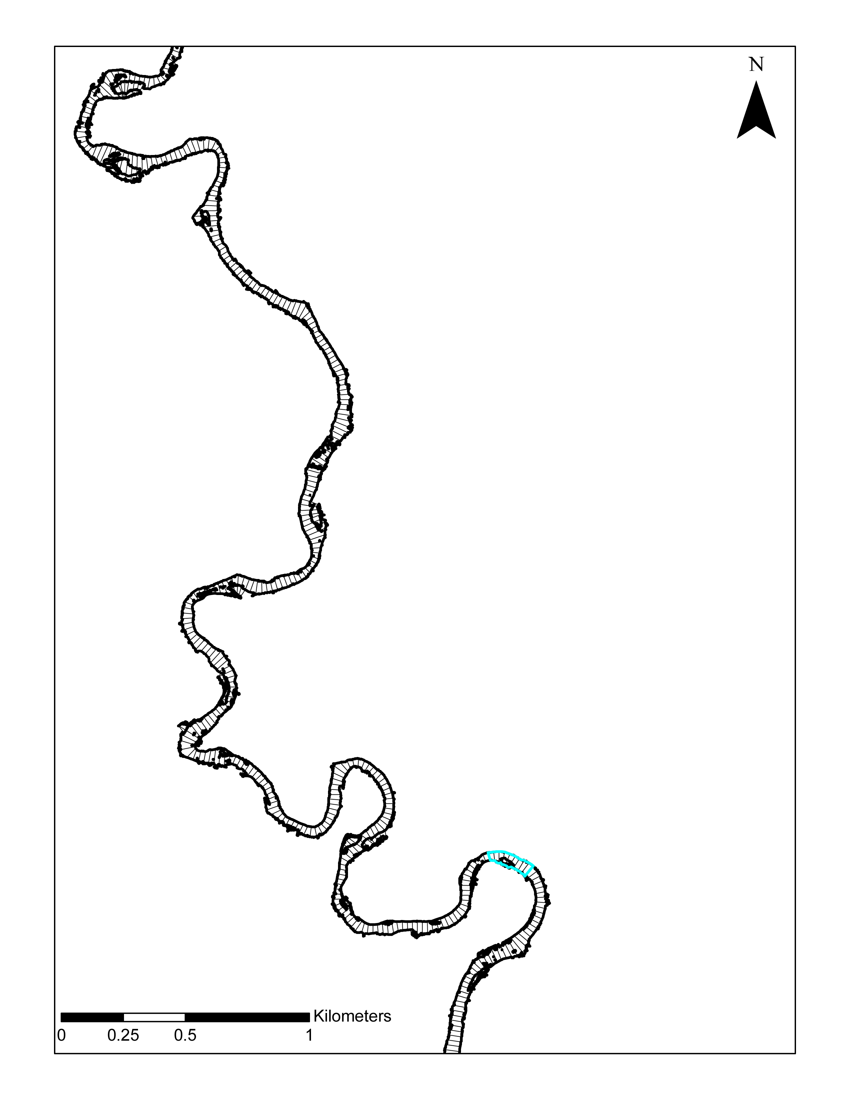
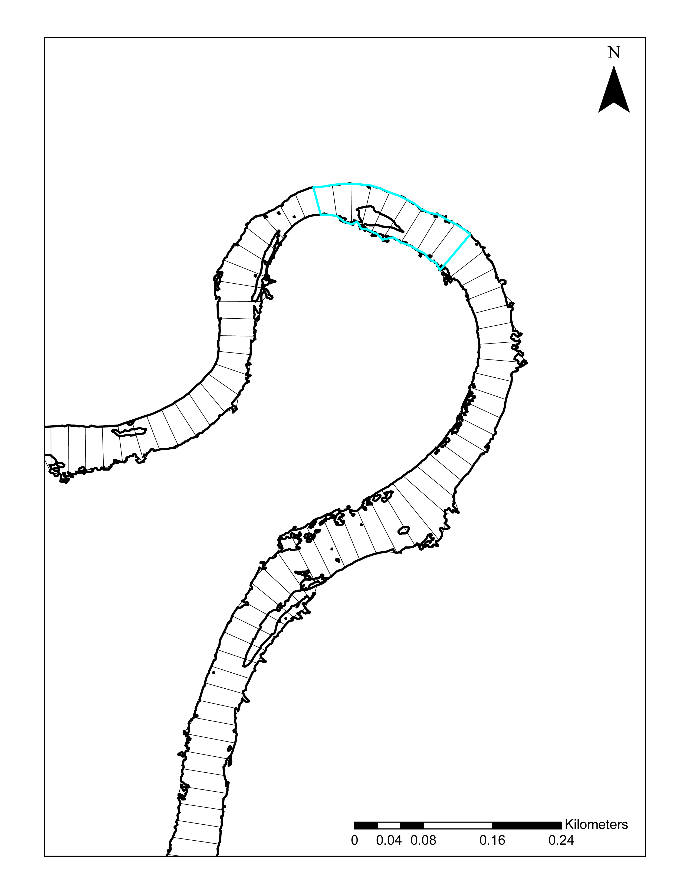
Moving Window .Shp Output

Slide 27
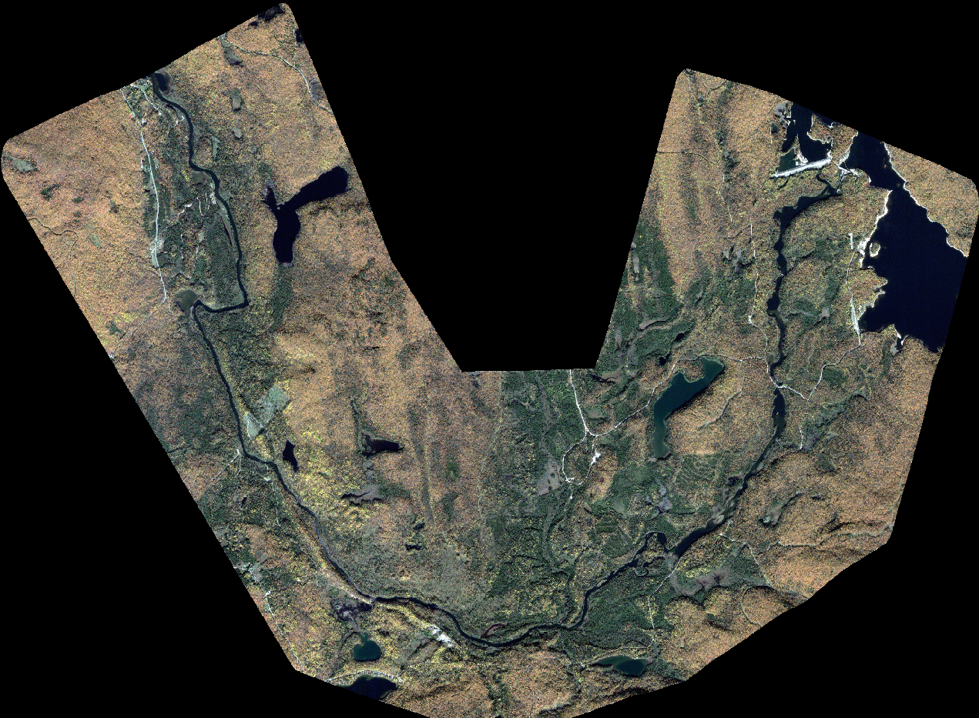
Moving Window - Results
Dam
Section 1:
Medium to high d and slow v
Section 3: Deep and slow (Pools)
Flow direction
Section 2:
Medium depth and fairly rapid (Runs)

Slide 28
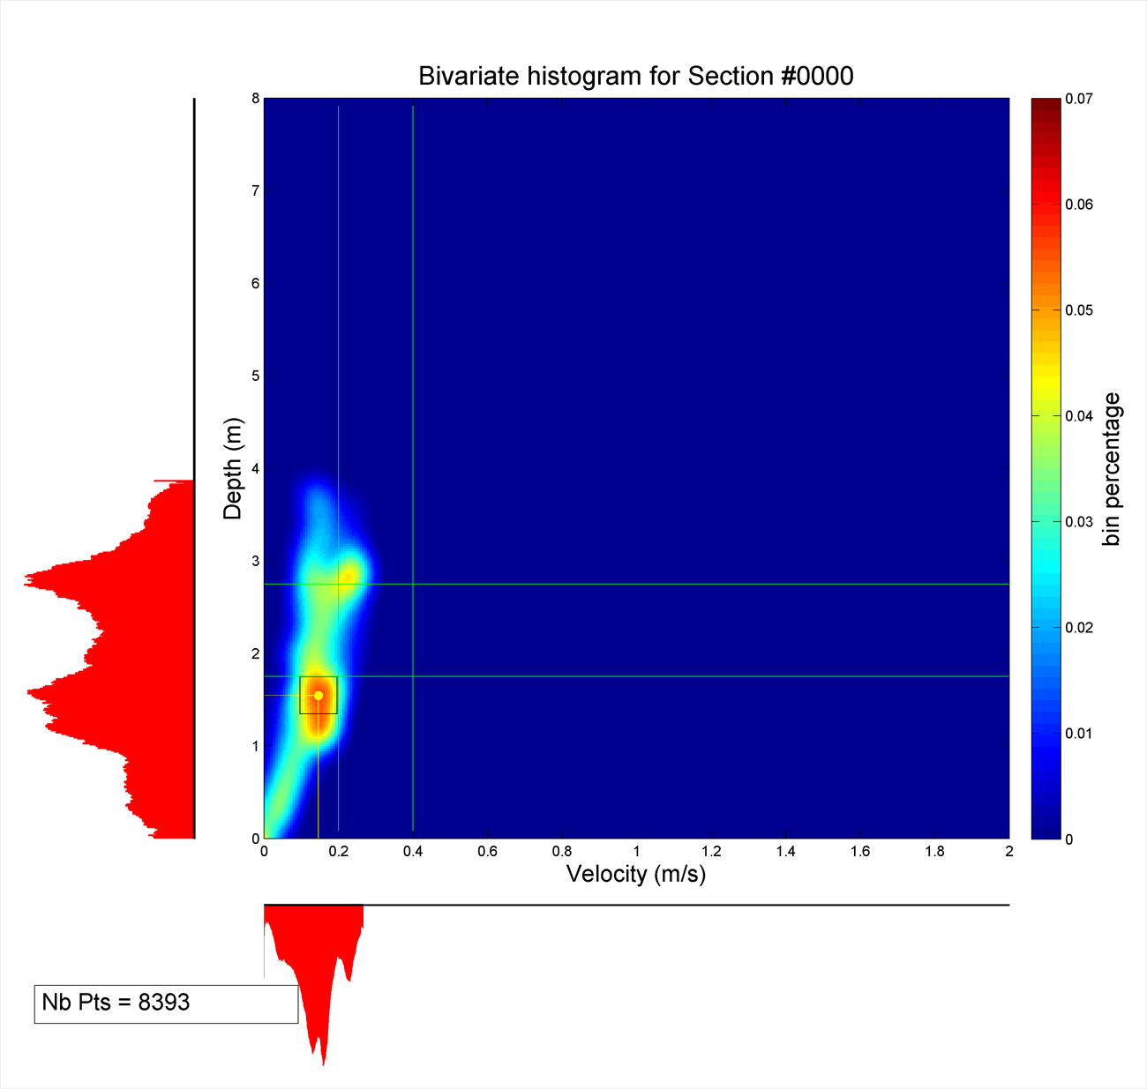
Moving Window - Results (1) Bivariate histogram

Slide 29
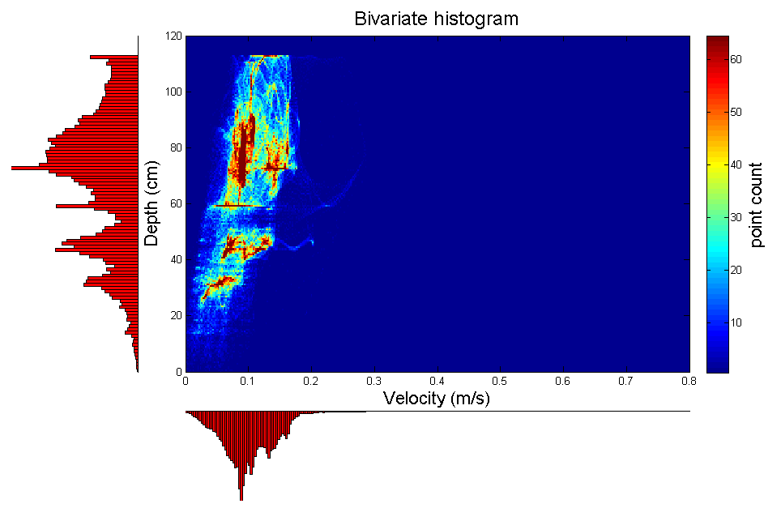
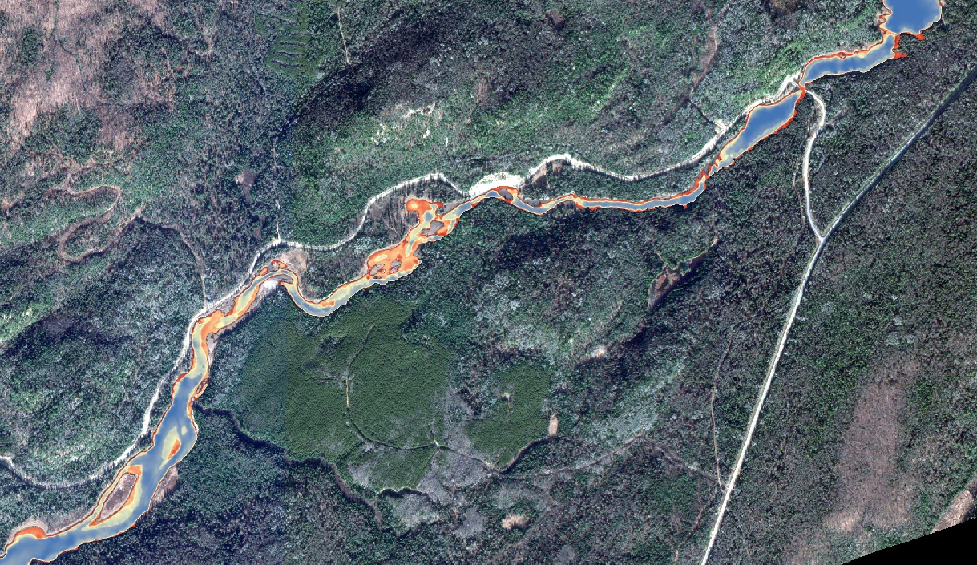
Moving Window – Results (1)
Mississagi river, ON
4
3
2
1
300 m

Slide 30
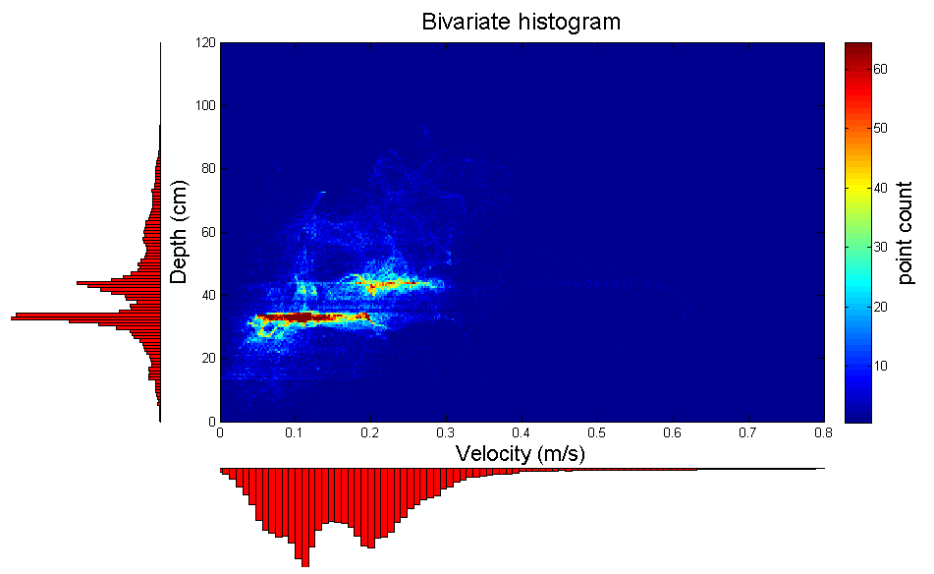
Moving Window - Results (1)
Section 2: Variable, shallow
4
3
2
1
300 m

Slide 31
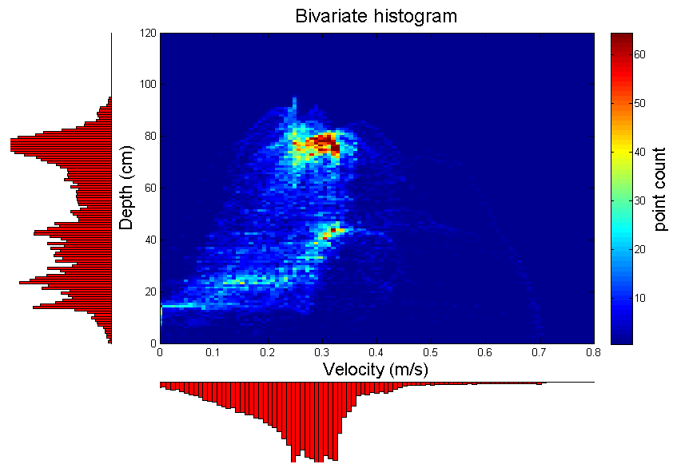
Moving Window - Results (1)
Section 3: Straight, narrow
4
4
3
3
2
2
1
1
300 m
300 m

Slide 32
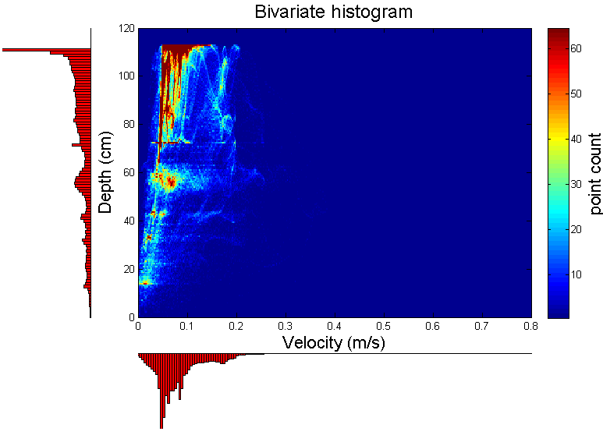
Moving Window - Results (1)
Section 4: Large deep pools, slow
4
3
2
1
300 m

Slide 33
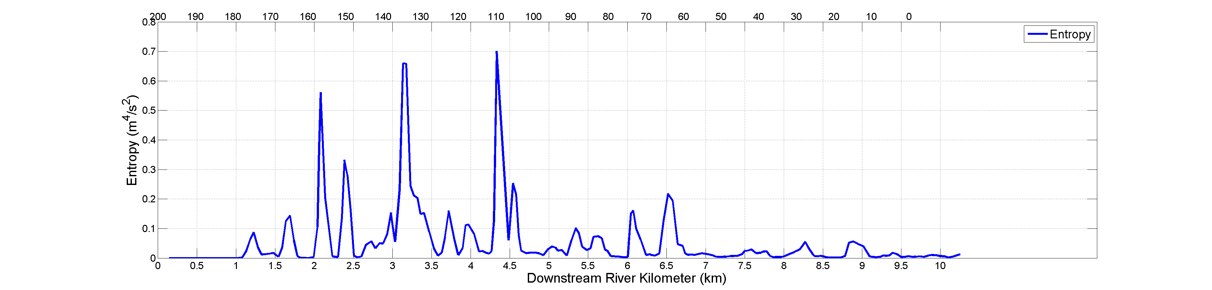
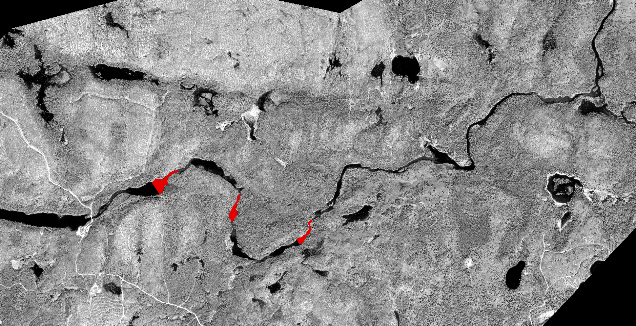
Moving Window – Results (2) Metrics
Metrics
Modal velocity
Modal depth
River width
Width/Depth ratio
Homogeneity factor
Heterogeneity (Entropy)
Heterogeneity (HMID)
Fast-Shallow Habitat
Slow-Shallow Habitat
Slow-Deep Habitat

Slide 34
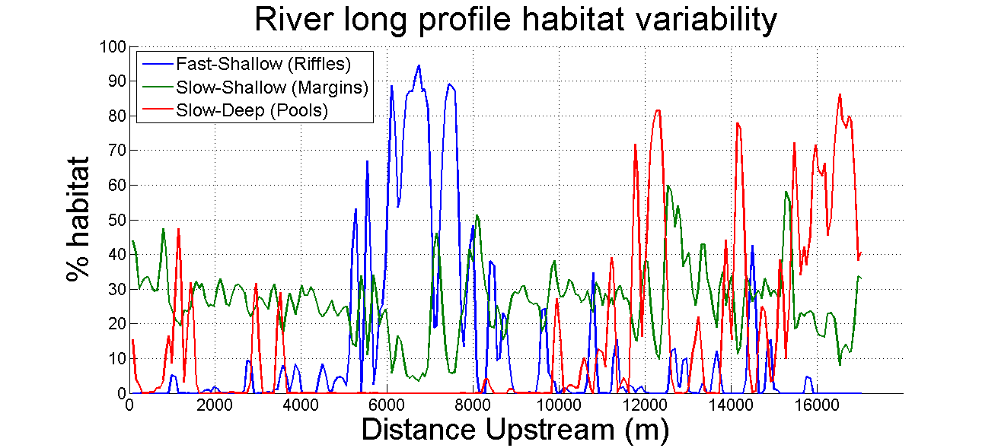
Moving Window – Results (2) Metrics
But 4th section: Complex transition zone not necessarily obvious to the eye
Section 3: Deep and slow (Pools)
Section 1:
small Pools
Section 2:
Riffles

Slide 35
Local Moving Window
Same principle but usability is more in field work validation:
Field data delimited by couples of points (or objects)
Creates polygons and exports underlying raster data to .txt file similarly to Moving Window
Reach covered by polygon can be increased => fish movement
=> In our case: used to validate biology and morphology database from field

Slide 36
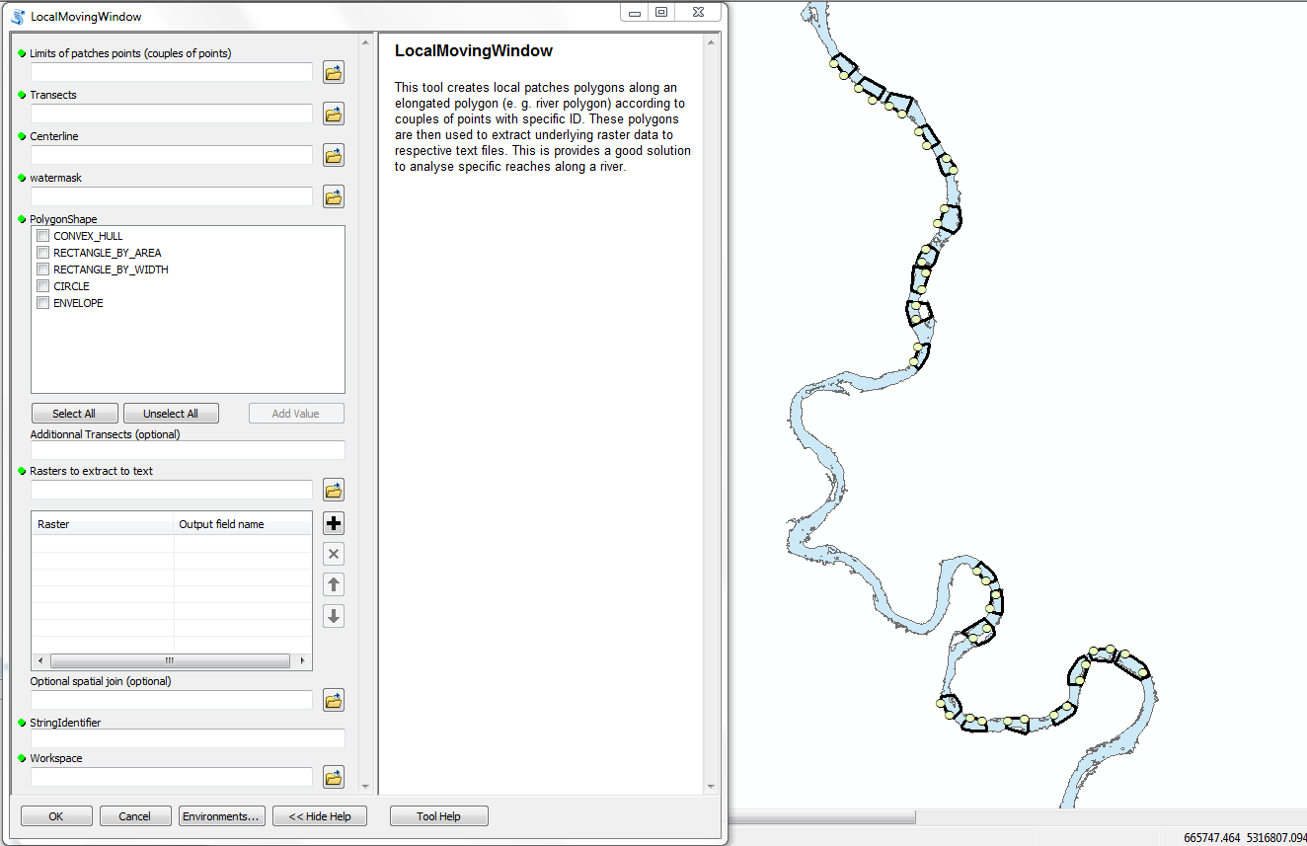
Local Moving Window

Slide 37
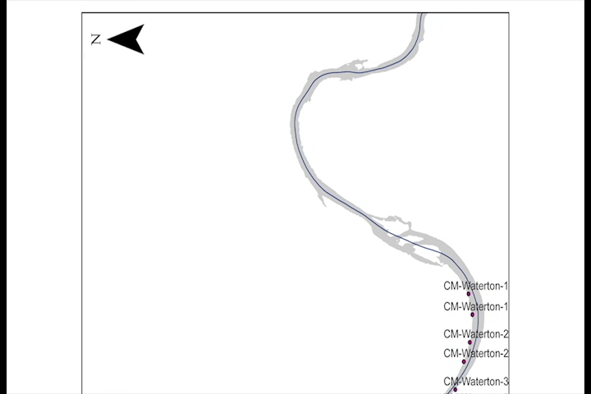
Local Moving Window –Shp Output

Slide 38
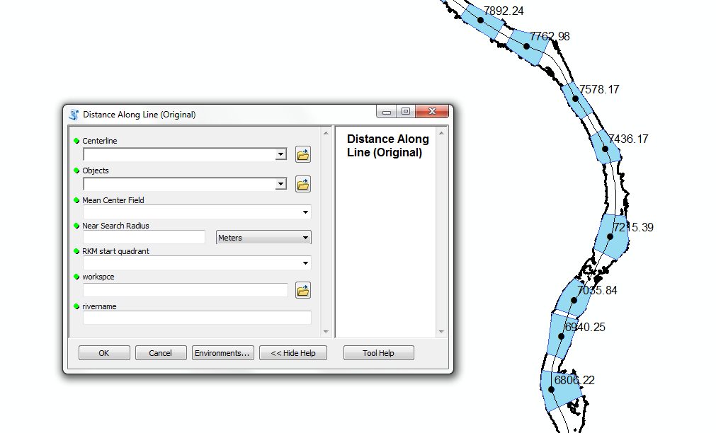
Distance Along Line (DAL)
=> Cumulative distance system along centerline.

Slide 39
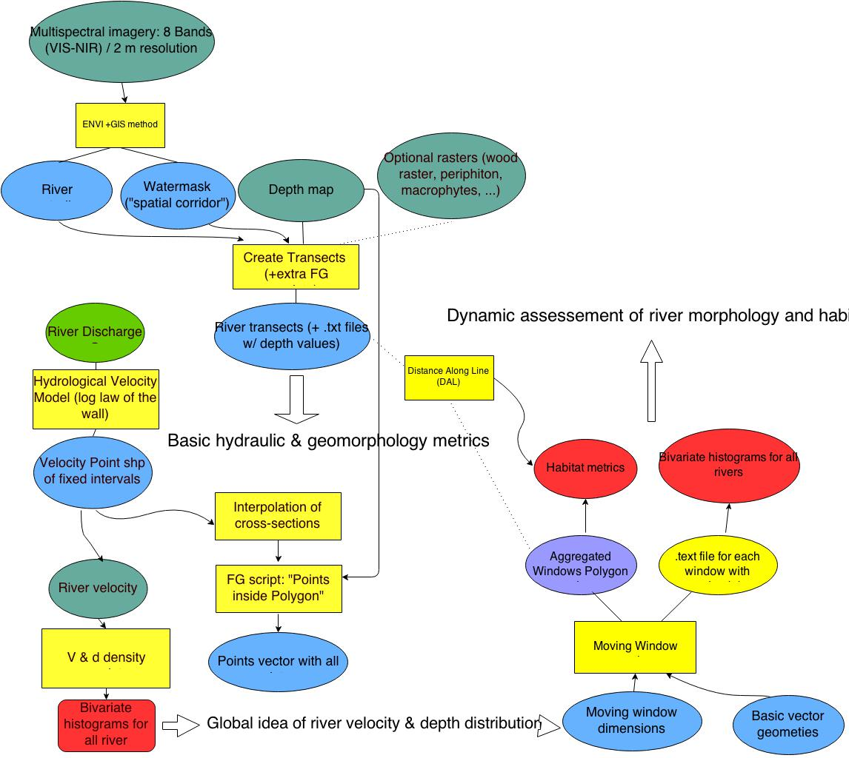
Method summary
Stats!!

Slide 40
Conclusion
Fluvial Geomorphology toolbox provides:
Fixed & dynamic geometries for different metric calculation
Field work validation
Simple geometries increase usability, good for academia
Perspectives:
-Inter-region habitat variability study & Regulated Vs. Natural rivers
More images -> can Python and arcpy module handle it?
=>open source solution using GDAL & OGR, .Net (C#)?

Slide 41
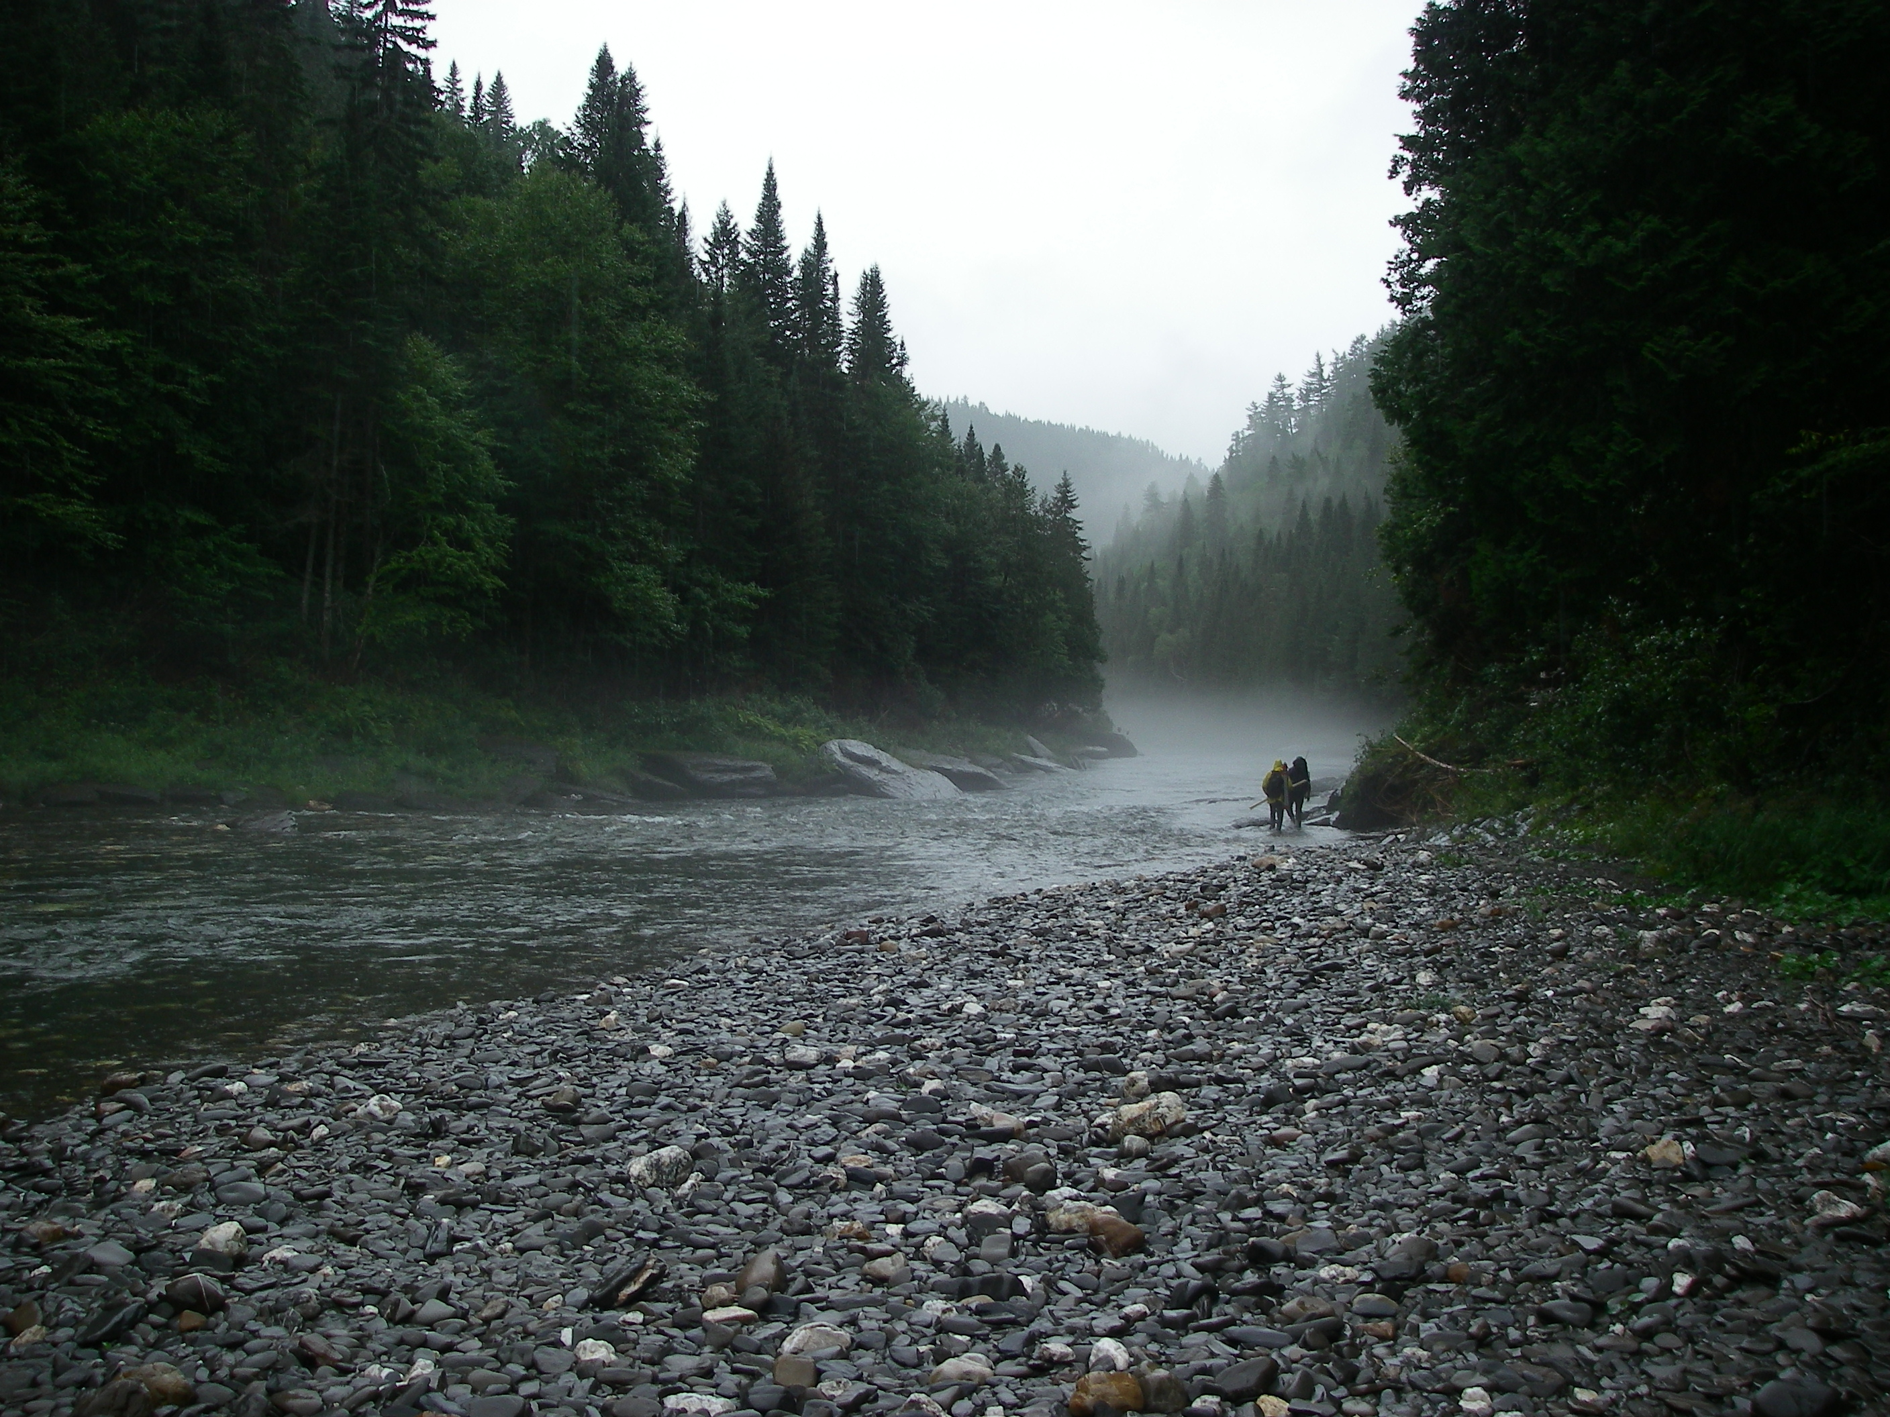
Toolbox availability
Toolbox availability
adrienlepoutre.com/Downloads/
adrienlepoutre@mail.mcgill.ca
McGill U. GIC website

